Slide 1


DECODELABS
Expense
Tracker
Project 2 · Industrial Training Kit
Batch: 2026
Python Programming · Data Accumulation · Batch 2026

Slide 2

What Is This Project?
Key Skill
Build an Expense Tracker
Math operations & Accumulator pattern
total = total + new_expense
Write a Python script that lets users continuously enter expense amounts. The program accumulates each entry and displays a running total — demonstrating real-time data processing with mathematical precision.
Why It Matters
Foundation of backend data processing and financial logic in real systems.
Milestone
Complete Project 2 to unlock next-week projects. Quality-verified required.
DecodeLabs · Project 2

Slide 3



The IPO Model
Input → Process → Output · The blueprint of every computing system
INPUT
PROCESS
OUTPUT
The Gate
The Engine
The Display
▸ User types expense amount
▸ Accumulator receives value
▸ Format result clearly
▸ input() captures raw string
▸ total += new_expense
▸ f-string for currency
▸ Type conversion: int(input())
▸ State preserved in memory
▸ print(f'Total: {total:.2f}')
▸ Validates numeric entry
▸ Loop continues running
▸ Decoupled from logic
expense =
int(input(
'Enter amount: '
))
total = 0
while True:
total +=
expense
print(
f'Total Spent:\n Rs.{total:.2f}'
)

Slide 4
Phase 1: The Gatekeeper — Type Conversion
input() always returns a string. You must convert it to int() before doing math — or your program will concatenate instead of add.
❌ WITHOUT Conversion
✅ WITH int() Conversion
a = input() # '100'
b = input() # '50'
result = a + b
# Result: '10050' 💥
a = int(input()) # 100
b = int(input()) # 50
result = a + b
# Result: 150 ✓
String concatenation — catastrophic in financial logic!
Correct arithmetic — the foundation of every numeric program.
DecodeLabs · Project 2

Slide 5
The Accumulator Pattern
State(new) = State(old) + Input · The heartbeat of data-driven programs
+₹200
total = 425
+₹75
total = 225
+₹50
→
total = 150
+₹100
→
total = 100
Start
→
total = 0
→
total += new_expense ←→ total = total + new_expense ←→ State(n) = State(n-1) + Input

Slide 6
Anatomy of State: Where to Initialize
✅ OUTSIDE the Loop (Memory)
❌ INSIDE the Loop (Amnesia)
total = 0 # initialized once
while True:
expense = int(input())
total += expense # grows
print(total)
while True:
total = 0 # RESET every time!
expense = int(input())
total += expense
print(total) # always = last entry
Accumulates correctly across all entries.
Forgets previous entries — logic destroyed.
DecodeLabs · Project 2

Slide 7
Defensive Coding & the Kill Switch
Guard your inputs. Control your loop. Exit gracefully.
try / except — The Poka-Yoke
Sentinel Value — The Kill Switch
try:
expense = int(input(
'Enter amount: '
))
total += expense
except ValueError:
print('⚠ Enter numbers only.')
continue # skip bad input
Standard Path:
User enters a number → add to total → loop again
Sentinel Path:
User types 'done' → break loop → print final total
data = input('Amount or done: ')
if data.lower() == 'done':
break
total += int(data)
Catches invalid text (e.g. 'ten') before it crashes the program. Always wrap user input in try/except.
SENTINEL = a special value that signals 'stop processing'

Slide 8
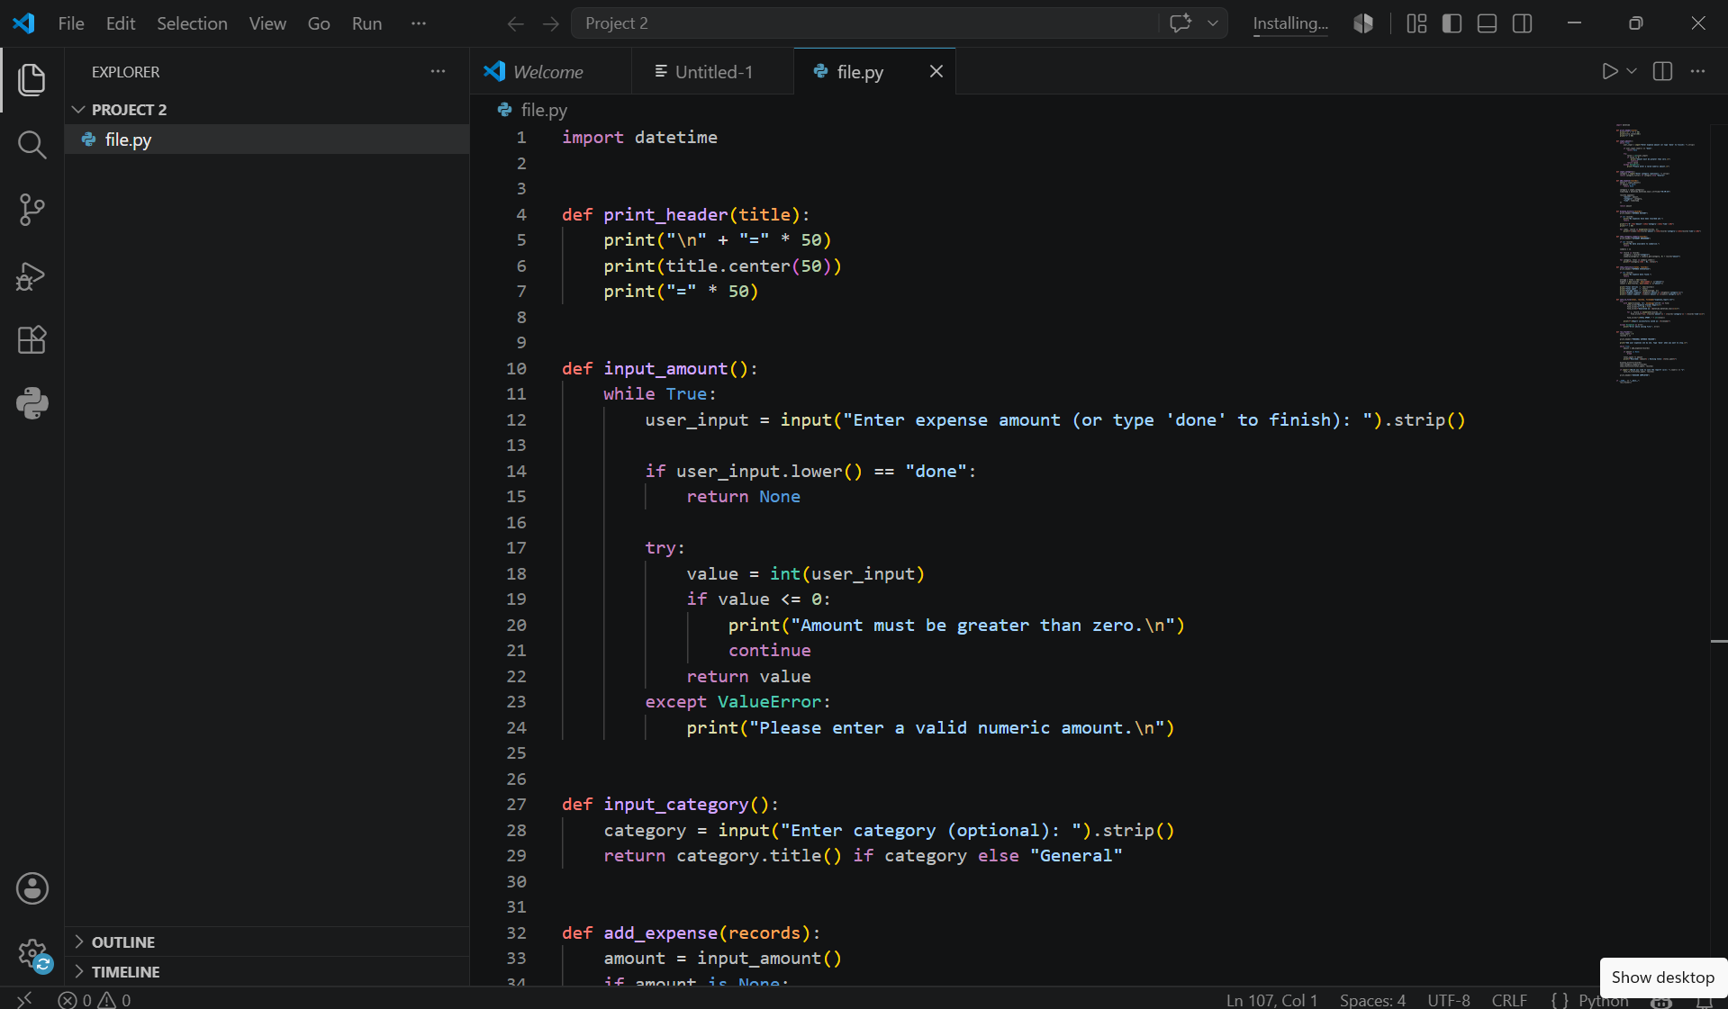

Slide 9
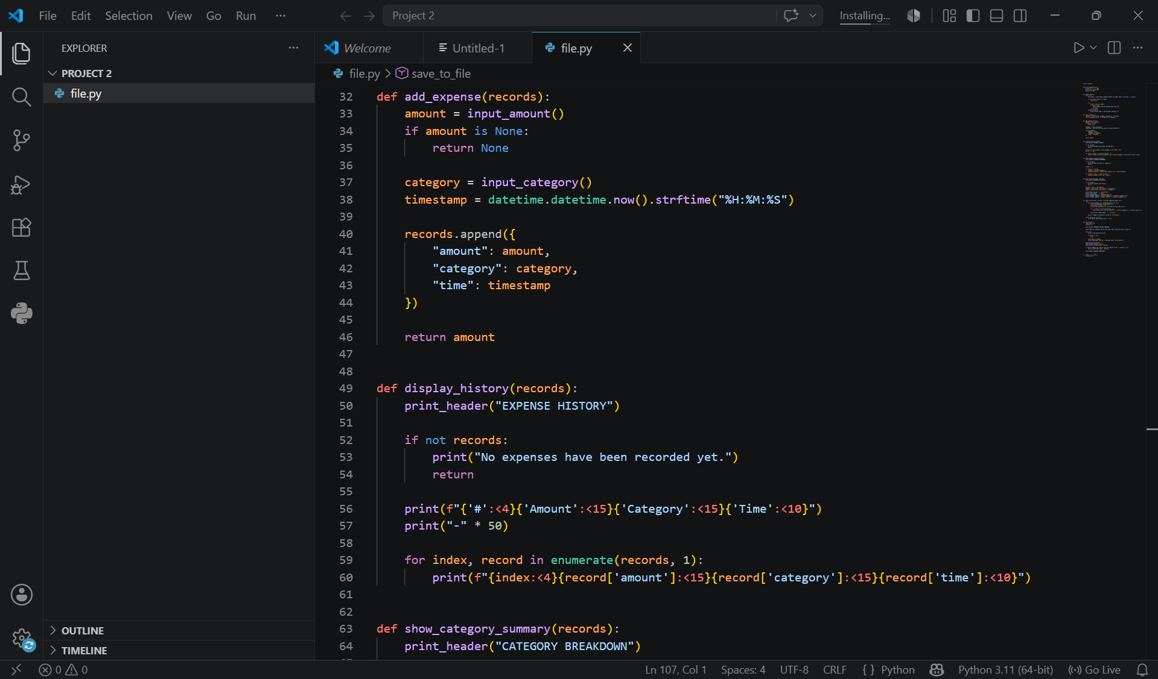

Slide 10
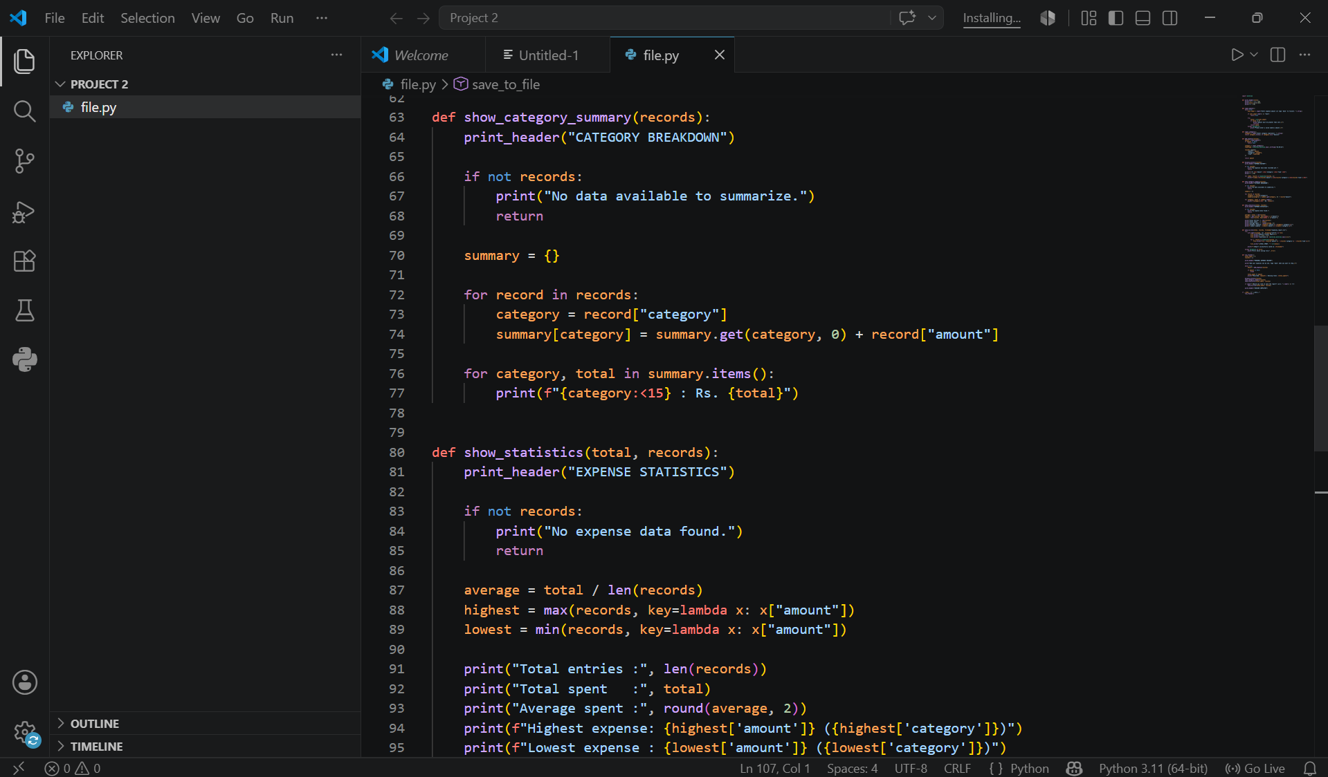

Slide 11
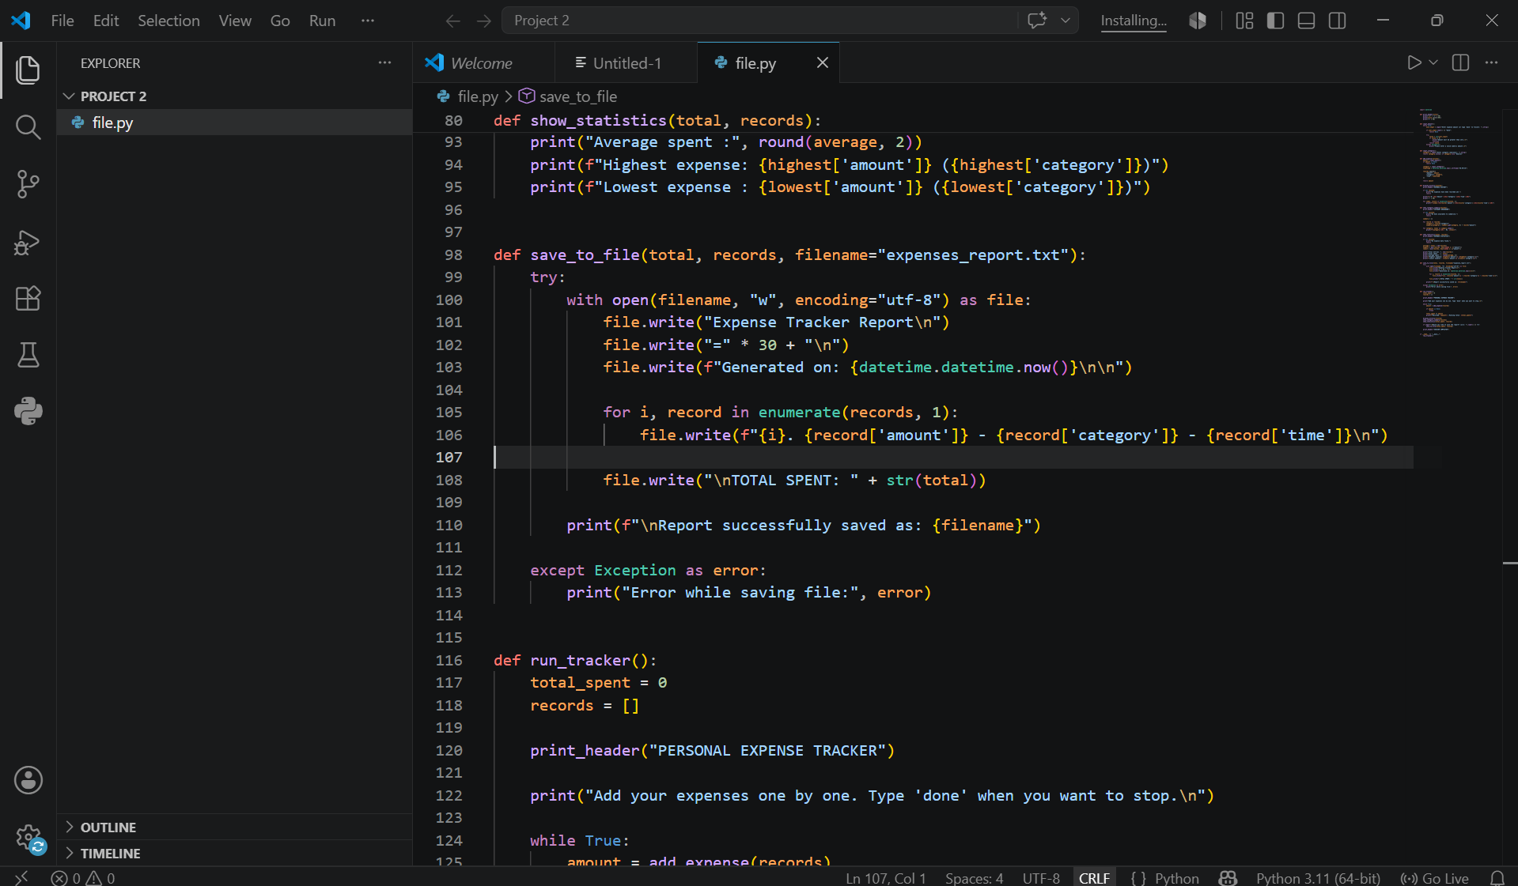

Slide 12
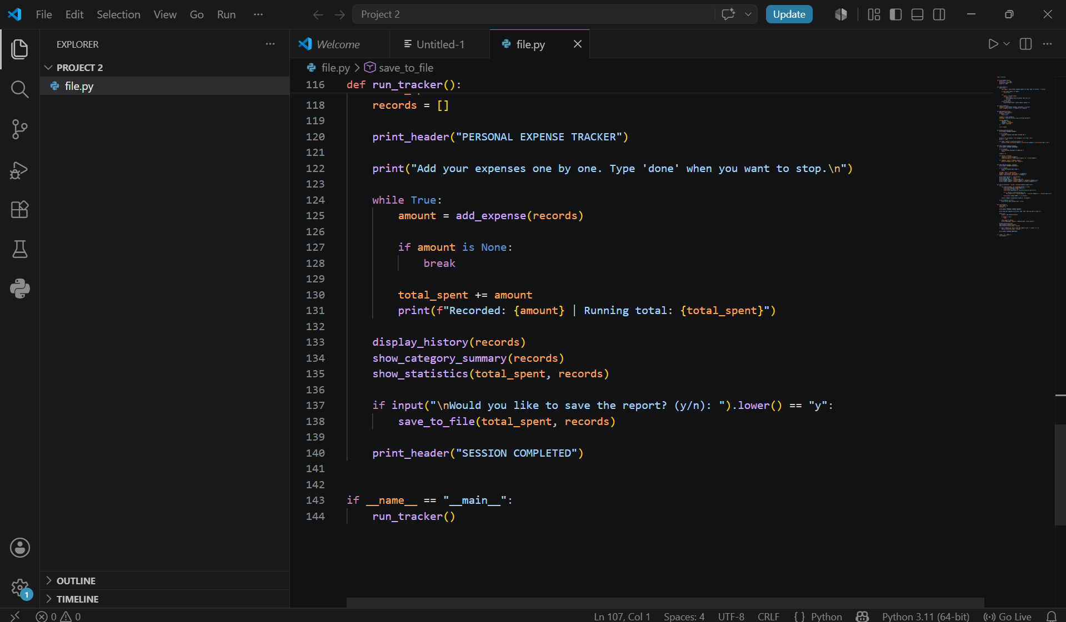

Slide 13




Quality Standard — 4-Point Audit
01
Stability
02
State Management
Handles 5+ consecutive expense entries without crashing, resetting, or losing previous values.
Variable `total` is initialized ONCE outside the while loop — not reset on every iteration.
03
Defensive Input
04
Controlled Exit
try/except ValueError catches non-numeric input gracefully — never crashes on bad data.
Kill switch (sentinel value 'done') breaks the loop cleanly and prints the verified final total.
DecodeLabs · Project 2

Slide 14

INPUT.
PROCESS.
OUTPUT.
TRUTH.

Slide 15
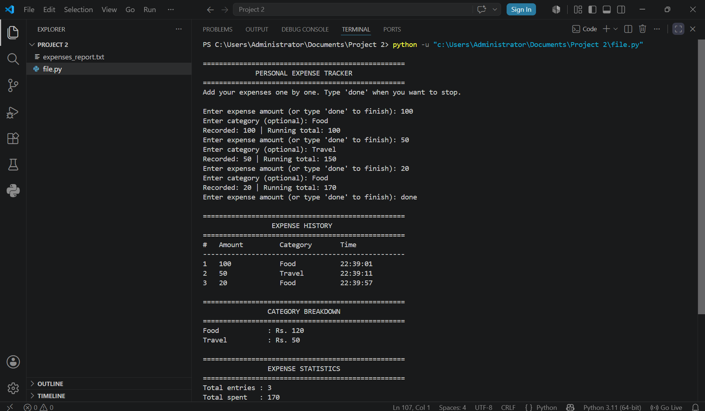

Slide 16
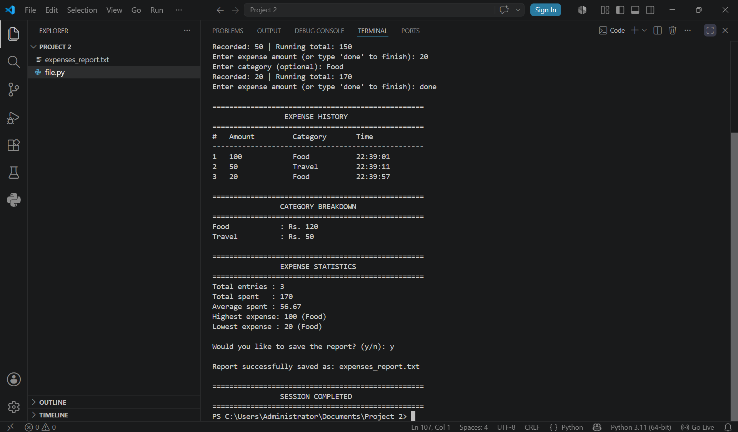

Slide 17
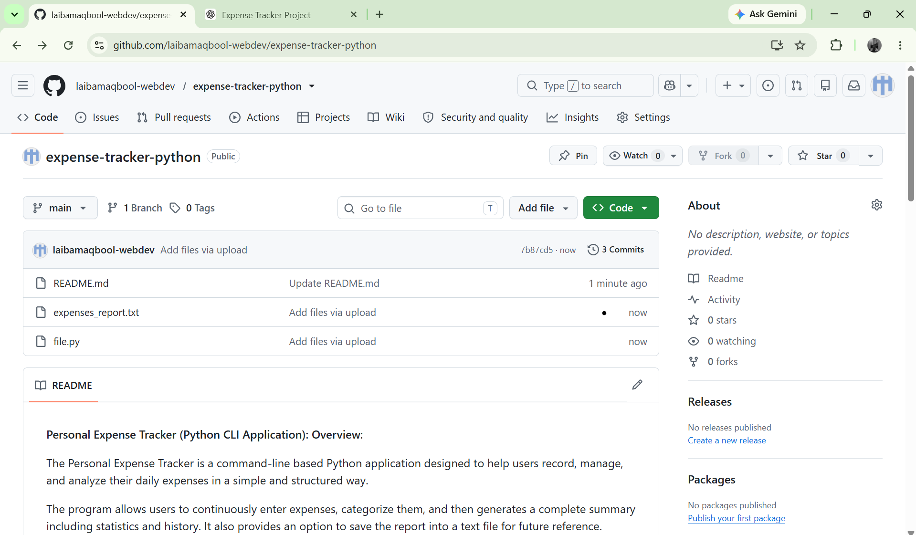

Slide 18
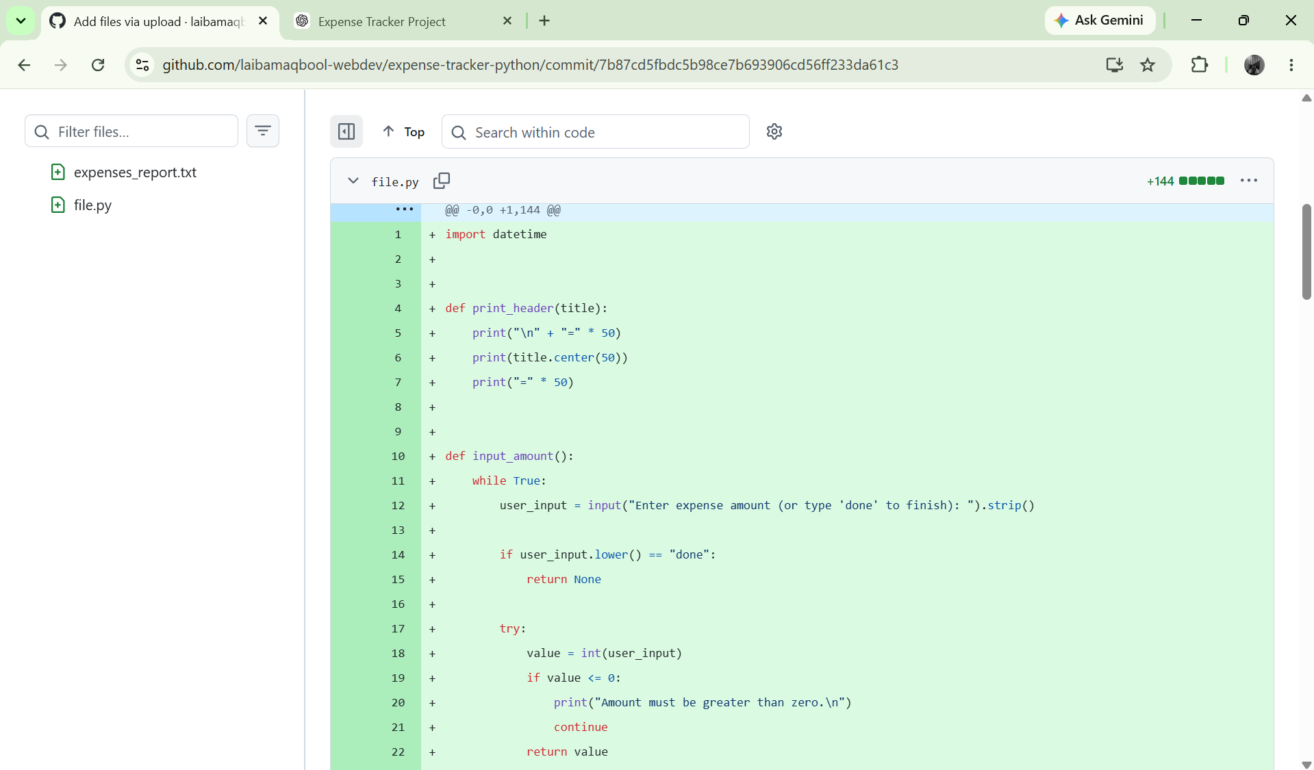

Slide 19

DecodeLabs
Industrial Training · Python Programming · Batch 2026
✉
🌐
📍
decodelabs.tech@gmail.com
www.decodelabs.tech
Greater Lucknow, India
Your journey to professional development begins with the very first line you write today.
Project 2 Complete · Expense Tracker · DecodeLabs 2026

